Slide 1
Limit & Continuity

Slide 2
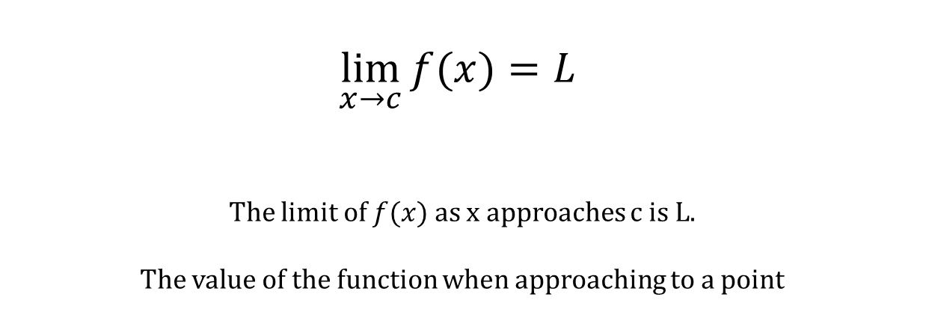
Notation
$$\lim_{x→c}{f(x)}=L$$
The limit of $f(x)$ as x approaches c is L.
The value of the function when approaching to a point

Slide 3

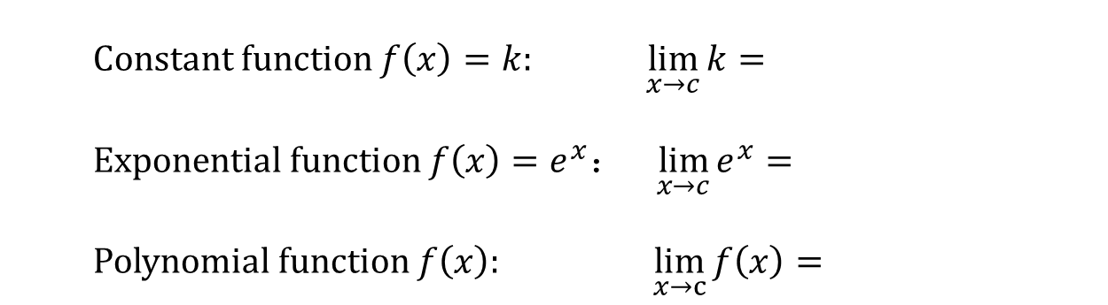
Basic Limits
Constant function $f\left(x\right)=k:$ $\lim_{x→c}{k}=$
Exponential function $f\left(x\right)=e^{x}： \lim_{x→c}{e^{x}}=$
Polynomial function $f\left(x\right):$ $\lim_{x→c}{f\left(x\right)=}$
$$k$$
$$e^{c}$$
$$f(c)$$
Limit of continuous functions at a point must exist.
→ Sub the point into directly!

Slide 4

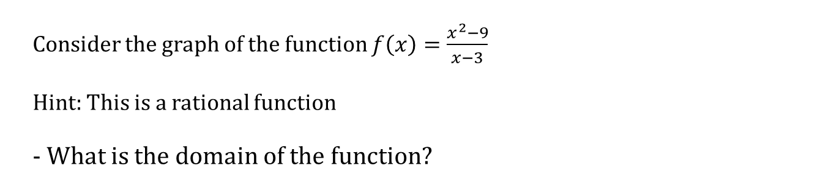
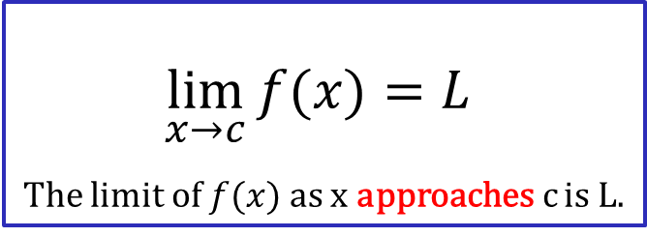
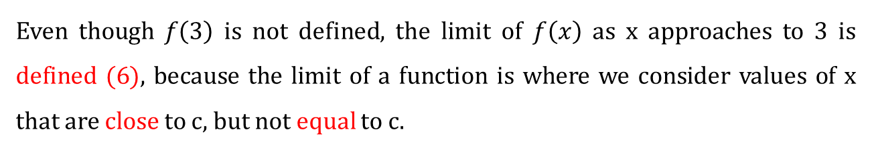
Finding Limits Graphically
Consider the graph of the function $f\left(x\right)=\frac{x^{2}−9}{x−3}$
Hint: This is a rational function
- What is the domain of the function?
$$\lim_{x→c}{f(x)}=L$$
The limit of $f(x)$ as x approaches c is L.
$$\lim_{x→3}{f(x)}= ?$$
Even though $f\left(3\right)$ is not defined, the limit of $f\left(x\right)$ as x approaches to 3 is defined (6), because the limit of a function is where we consider values of x that are close to c, but not equal to c.

Slide 5
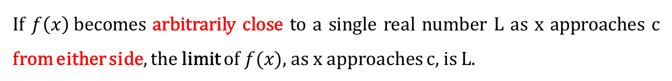
Definition
If $f\left(x\right)$becomes arbitrarily close to a single real number L as x approaches c from either side, the limit of $f(x)$, as x approaches c, is L.
If, while approaching a specific input value from either side, your outputs also approach a particular value, that output value is called the “limit.”
Note: We can have a limit at c even if the function is undefined at c.
The limit describes the behavior of the function near a point, not at the point.

Slide 6
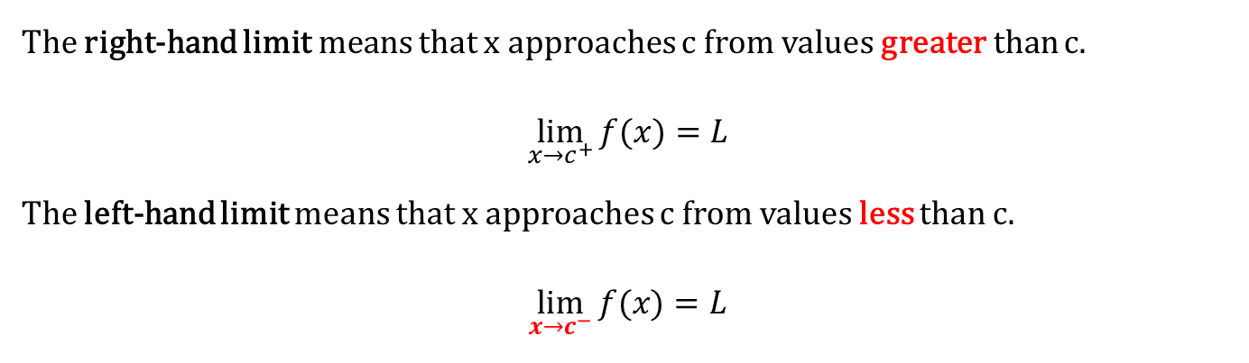
One-sided Limit
If $f\left(x\right)$becomes arbitrarily close to a single real number L as x approaches c from either side, the limit of $f(x)$, as x approaches c, is L.
Left-hand
Right-hand
The right-hand limit means that x approaches c from values greater than c.
$$\lim_{x→c^{+}}{f(x)}=L$$
The left-hand limit means that x approaches c from values less than c.
$$\lim_{x→c^{−}}{f(x)}=L$$

Slide 7


The existence of a Limit
The limit of $f\left(x\right)$ as x approaches c is L
$$\lim_{x→c^{−}}{f(x)}=\lim_{x→c^{+}}{f(x)}=L$$

Slide 8
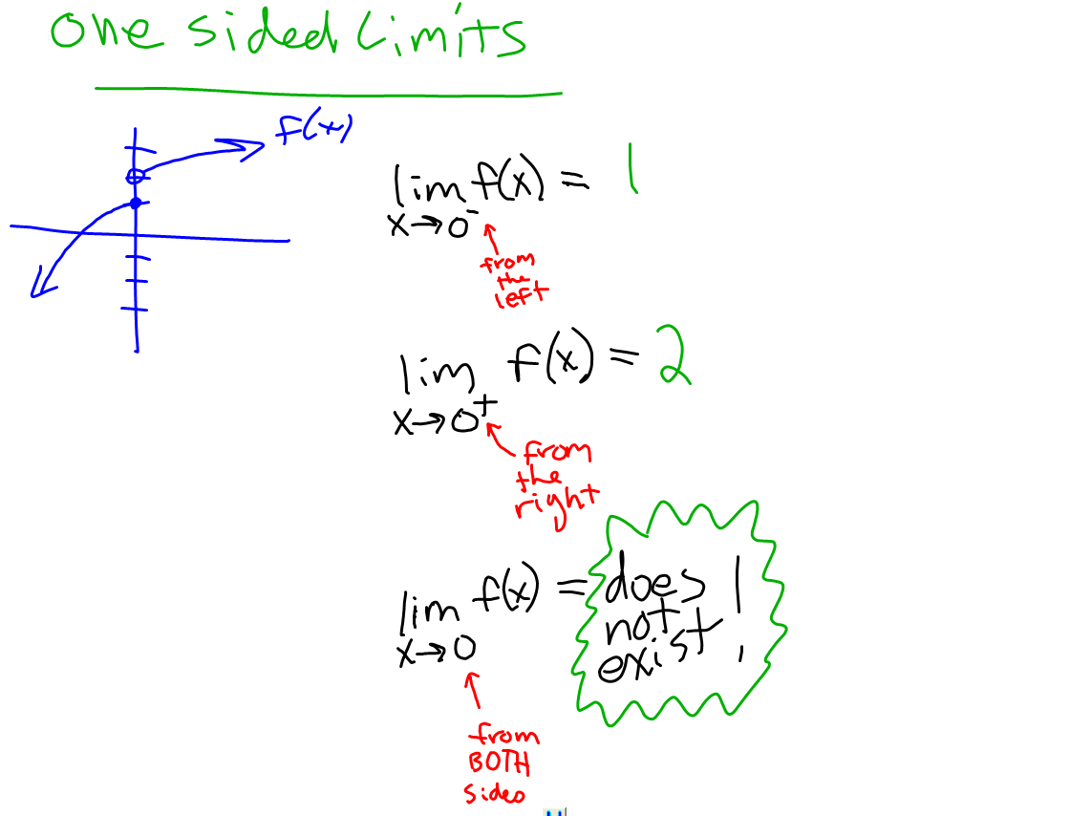

Slide 9
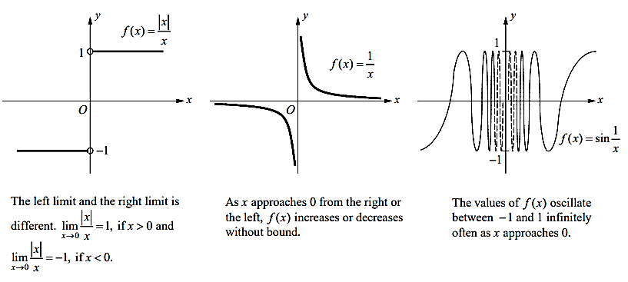
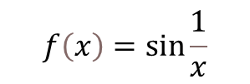

Limits that fails to exists
$$f\left(x\right)=\frac{\left|x\right|}{x}$$
Jump
Infinity
Oscillate too much to have a limit
$f\left(x\right)=tanx$ $f\left(x\right)=\frac{1}{x}$
$$f\left(x\right)=\sin{\frac{1}{x}}$$

Slide 10
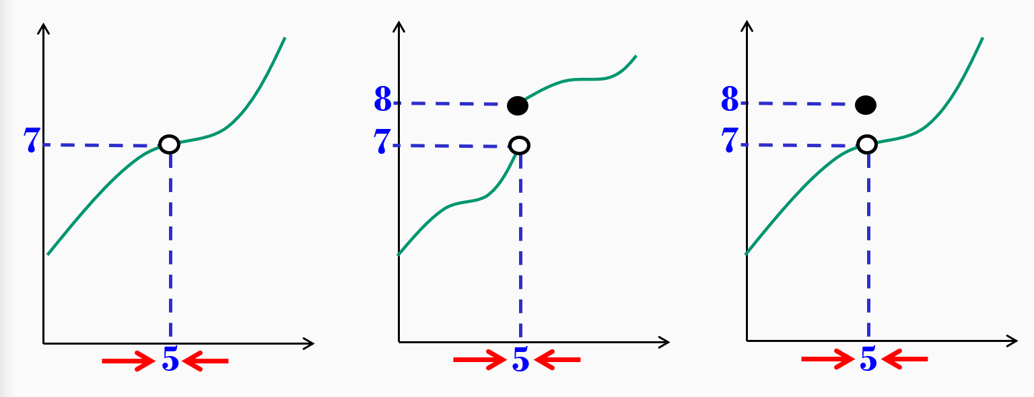

Continuity
A function f is continuous at c if the following three conditions are met.
$\lim_{x→c}{f(x)}$ exists
$f\left(c\right)$ is defined
$\lim_{x→c}{f(x)}=f(c)$
f(c)
c

Slide 11
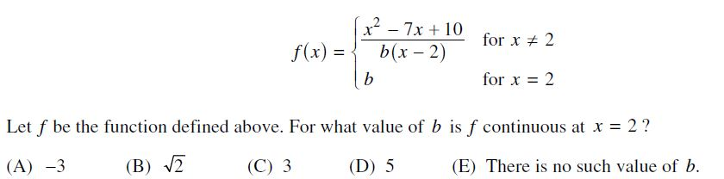



$$f\left(x\right)=\frac{(x−5)(x−2) }{ (x−2)}=(x−5)$$
At $x=2$, a hole exists at $\left(2, −3\right)$
A
ANSWER
Just for fun, here’s the actual AP Question from 2014

Slide 12
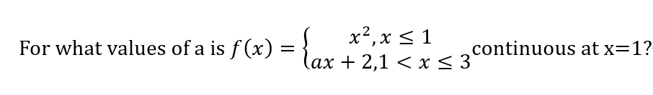
PROOF of CONTINUITY Justify using “the definition of continuity.”
Show that the 3 conditions have been met
Draw the conclusion precisely
Reference the theorem or definition that allows us to make this claim

Slide 13
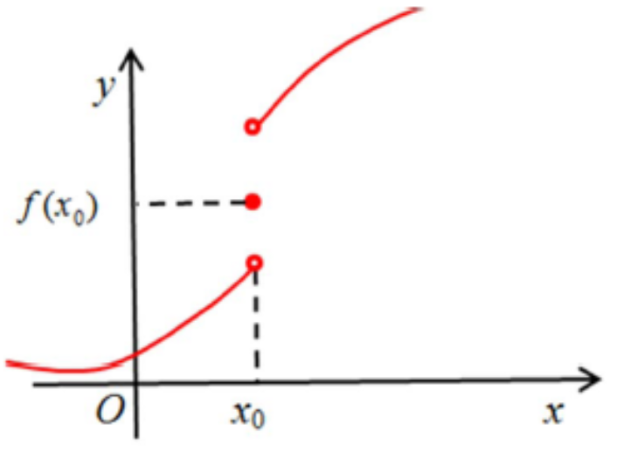
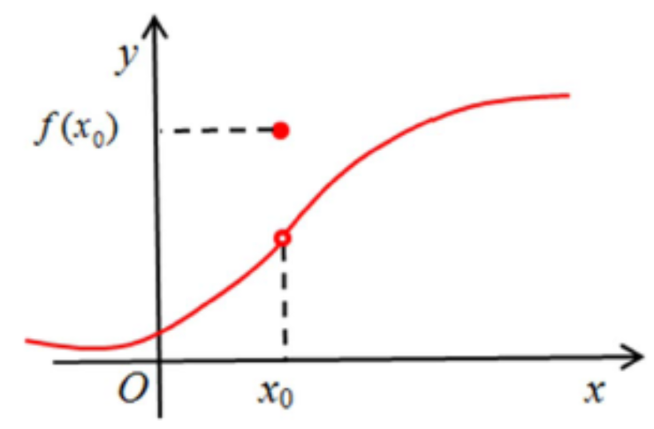
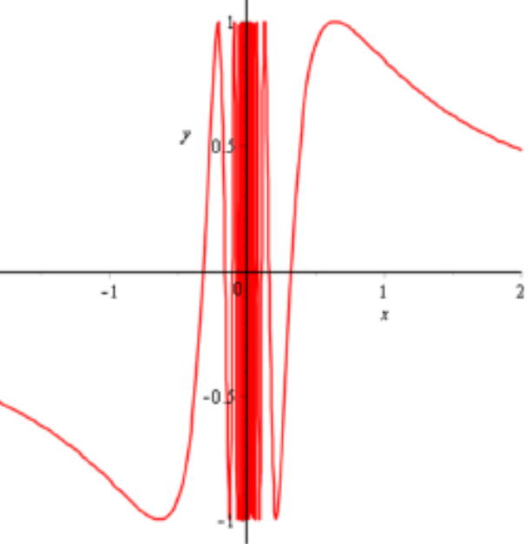
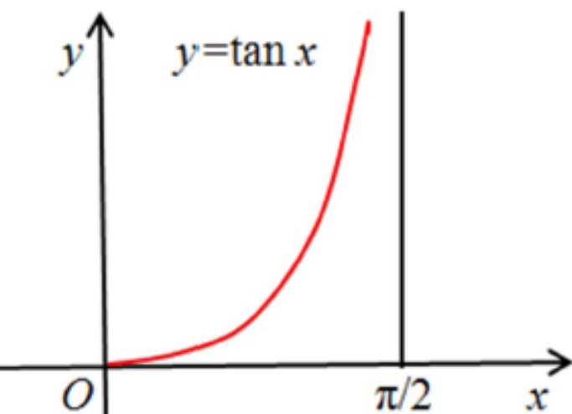
Discontinuities
Jump Discontinuity
2. Discontinuity due to vertical asymptote
2. Removable Discontinuity

Slide 14

Techniques for Evaluating Limits
Direct Substitution
$\lim_{x→−1}{x^{3}−2x}$
2. Remove the hole by cancellation
$\lim_{x→2}{\frac{x^{2}−4}{x−2}}$ $\lim_{x→2}{\frac{x^{2}+3x−10}{x−2}}$
3. Rationalizing
$\lim_{x→0}{\frac{\sqrt{x+1}−1}{x}}$ $\lim_{x→0}{\frac{\sqrt{x+3}−2}{x−1}}$
4. Setting up two cases
$$\lim_{x→4}{\frac{\left|x−4\right|}{x−4}}$$

Slide 15
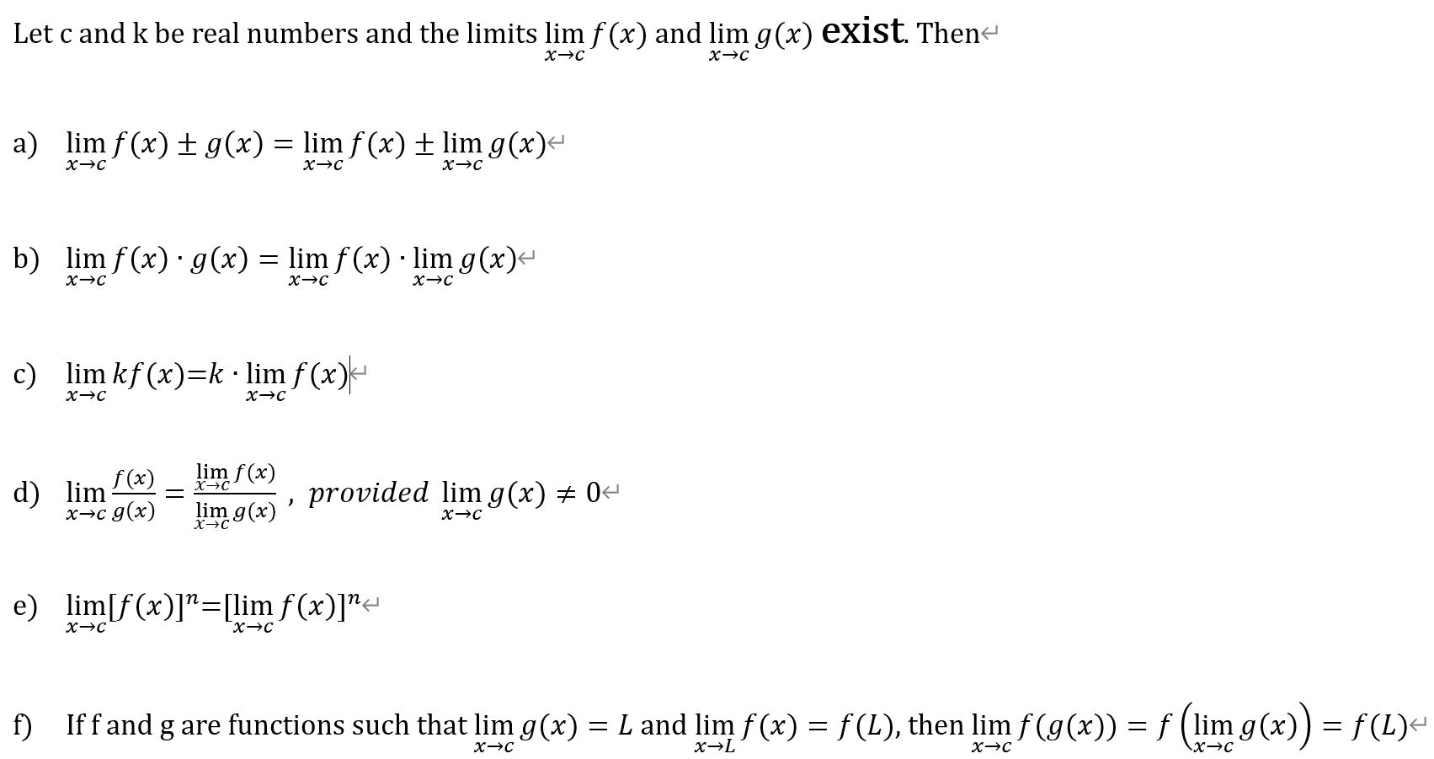

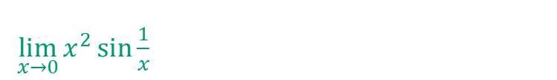
Limit Laws
$\lim_{x→0}{x^{2}\sin{\frac{1}{x}}}$
$$\lim_{x→0}{\frac{x^{2}+3x−10}{x−2}}$$

Slide 16
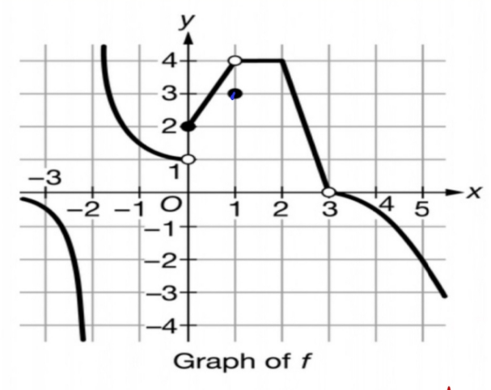
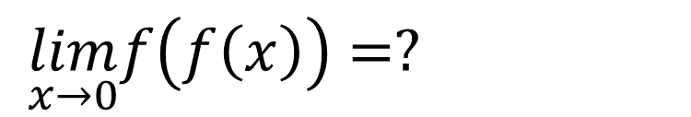
$\lim_{x→0}f\left(f\left(x\right)\right)=?$

Slide 17
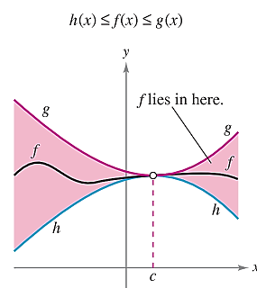
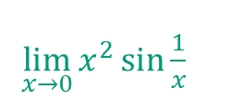
Squeeze Theorem
$\lim_{x→0}{x^{2}\sin{\frac{1}{x}}}$

Slide 18
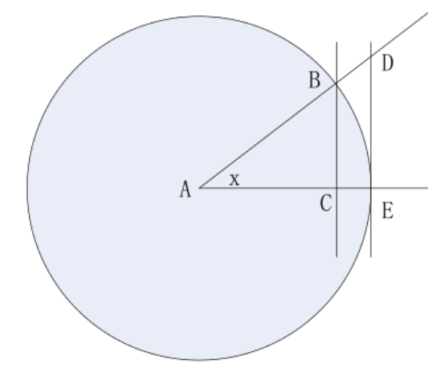
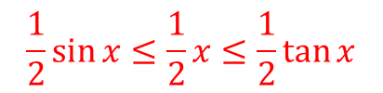






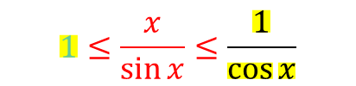



Special Limits
$$\lim_{x→0}{\frac{sinx}{x}}=__________$$
$$1$$
$$S_{ΔABC}≤S_{ABE}≤S_{ΔADE}$$
$$\frac{1}{2}\sin{x}≤\frac{1}{2}x≤\frac{1}{2}\tan{x}$$
$$\tan{x}$$
$$\sin{x}≤x≤\tan{x}$$
$$\sin{x}$$
$$\frac{\sin{x}}{\sin{x}}≤\frac{x}{\sin{x}}≤\frac{\tan{x}}{\sin{x}}$$
$$1≤\frac{x}{\sin{x}}≤\frac{1}{\cos{x}}$$
$1→1$ as $x→0$
$\frac{1}{\cos{x}}→1$ as $x→0$

Slide 19

$$Practice$$
$\lim_{x→0}{\frac{\sin{4x}}{3x}}$
$\lim_{x→0}{\frac{\tan{x}}{x}}$
$\lim_{x→\frac{π}{4}}{\frac{\tan{x}−1}{\sin{x}−\cos{x}}}$

Slide 20
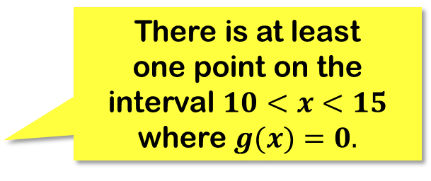
A function is said to be continuous over an interval if it has no breaks, jumps, or holes.
(the pencil never leaves the paper!)
Given that function g is continuous, and that $g(10)$is positive, while $g(15)$ is negative,
then you are required to draw a curve starting from $(10,g(10))$to $(15,g(15))$.
There is at least one point on the interval $10<x<15$ where $g(x)=0.$
10 15

Slide 21
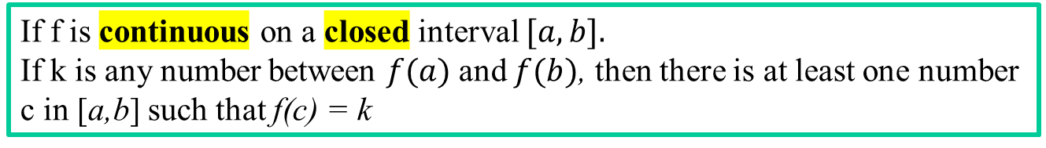
Intermediate Value Theorem
If f is continuous on a closed interval $[a,b].$
If k is any number between $f(a)$and $f(b)$, then there is at least one number c in [a,b] such that f(c) = k
f(b)
k
f(a)
a
c
b

Slide 22
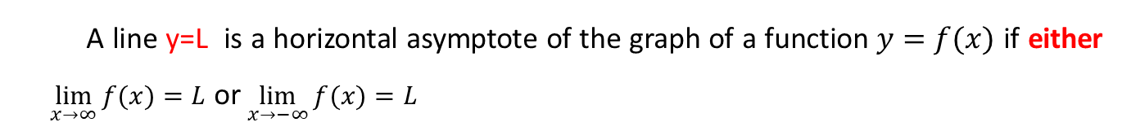
Limits at Infinity
If f(x) gets as close to a number L
when x gets sufficiently large, then…
similarly…
A line y=L is a horizontal asymptote of the graph of a function $y=f(x)$ if either $\lim_{x→∞}{f(x)}=L$ or $\lim_{x→−∞}{f(x)}=L$
Think “End Behavior” & “Horizontal Asymptote!”

Slide 23



Limits at Infinity – Summary of Rational Functions
$r\left(x\right)=\frac{a_{0}+a_{1}x+a_{2}x^{2}+…+a_{n}x^{n}}{b_{0}+b_{1}x+b_{2}x^{2}+…+b_{k}x^{k}}$
$n=k$
$n<k$
$n>k$
$\lim_{x→±∞}r\left(x\right)=\lim_{x→±∞}\frac{a_{0}+a_{1}x+a_{2}x^{2}+…+a_{n}x^{n}}{b_{0}+b_{1}x+b_{2}x^{2}+…+b_{n}x^{n}}$= $\lim_{x→±∞}\frac{a_{n}x^{n}}{b_{n}x^{n}}=\frac{a_{n}}{b_{n}}$
$\lim_{x→±∞}r\left(x\right)=\lim_{x→±∞}\frac{a_{n}x^{n}}{b_{k}x^{k}}$= $\frac{constant}{“∞”}$
$\lim_{x→±∞}r\left(x\right)=\lim_{x→±∞}\frac{a_{n}x^{n}}{b_{k}x^{k}}$= $\frac{“∞”}{constant}$

Slide 24
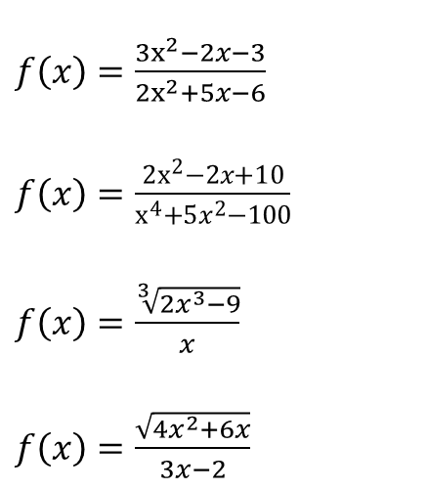
Practice -- Rational Function
$f\left(x\right)=\frac{3x^{2}−2x−3}{2x^{2}+5x−6}$
$f\left(x\right)=\frac{2x^{2}−2x+10}{x^{4}+5x^{2}−100}$
$f\left(x\right)=\frac{\sqrt[3]{2x^{3}−9}}{x}$
$f\left(x\right)=\frac{\sqrt{4x^{2}+6x}}{3x−2}$

Slide 25

Practice –- The Rapidity of Functions to Infinity
(a) $\lim_{x→∞}\frac{x^{3}−4x^{2}+7}{2x^{3}−3x−5}$
(b) $\lim_{x→∞}\frac{x^{100}}{e^{x}}$
(c) $\lim_{x→∞}\frac{x^{100}}{lnx}$
(d) $\lim_{x→∞}\frac{10−6x^{2}}{5+3e^{x}}$
(e) $\lim_{x→−∞}\frac{10−6x^{2}}{5+3e^{x}}$

Slide 26
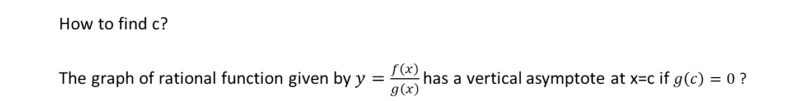
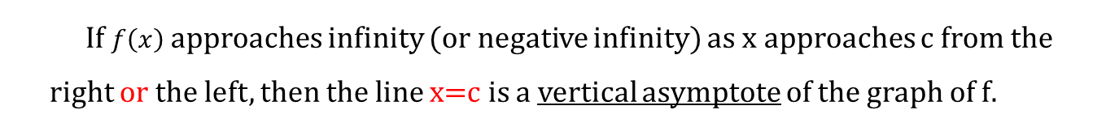

vertical asymptote
If $f\left(x\right)$approaches infinity (or negative infinity) as x approaches c from the right or the left, then the line x=c is a vertical asymptote of the graph of f.
$y=\frac{1}{x−3}$
3
How to find c?
The graph of rational function given by $y=\frac{f\left(x\right)}{g\left(x\right)}$ has a vertical asymptote at x=c if $g\left(c\right)=0$ ?

Slide 27
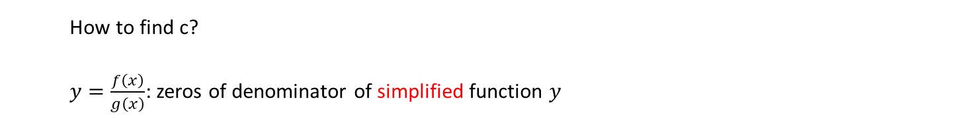
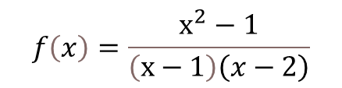

vertical asymptote
$$f\left(x\right)=\frac{x^{2}−1}{\left(x−1\right)\left(x−2\right)}$$
How to find c?
$y=\frac{f\left(x\right)}{g\left(x\right)}$: zeros of denominator of simplified function $y$
$g\left(x\right)=0$: vertical asy OR Hole

Slide 28
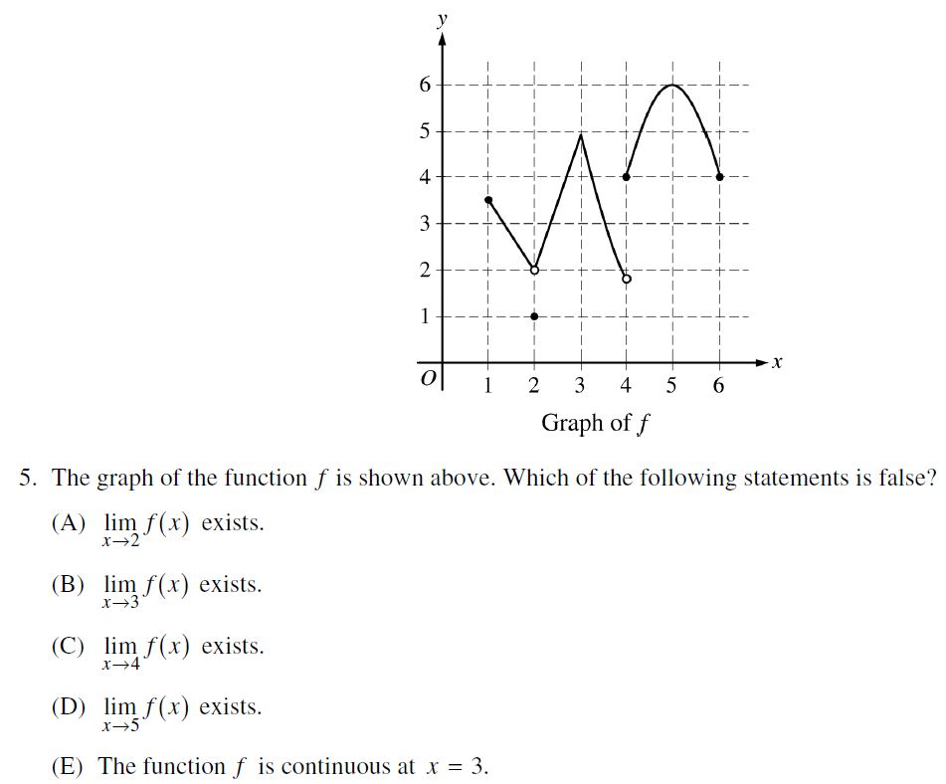

C
ANSWER

Slide 29

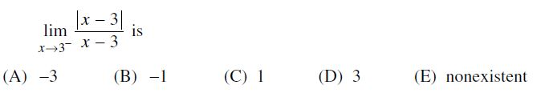
B
ANSWER

Slide 30

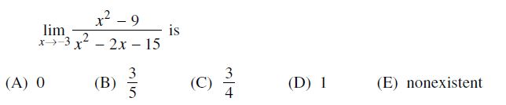
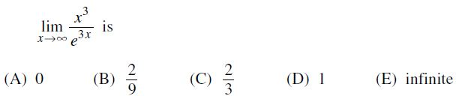
C
ANSWER
A
ANSWER

Slide 31
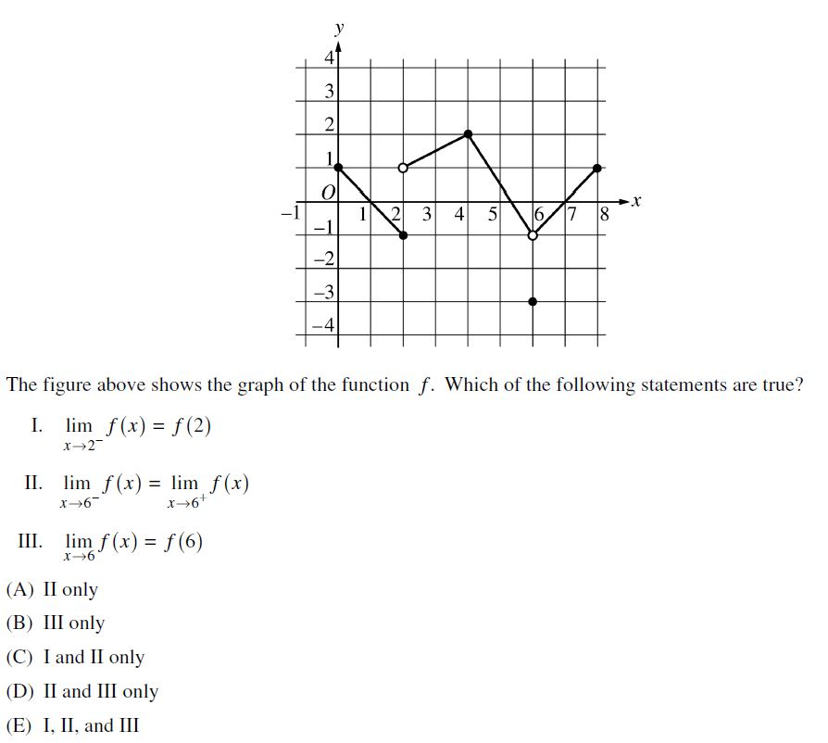

C
ANSWER

